Slide 1

GOLD PRICE
PREDICTION
SHORT-TERM FORECASTING OF XAU/USD DAILY PRICES USING AUTOREGRESSIVE AND DEEP LEARNING MODELS

Slide 2
PROJECT OVERVIEW
Key Features
Daily rolling prediction with auto-update
Lag-based autoregressive features (155 features)
Multiple model comparison
Trading signals generation
30-day future price forecast
Gold is one of the most important commodities in the global financial market, widely regarded as a safe-haven asset during economic uncertainty.
This project develops a machine learning-based system for next-day gold price prediction using historical daily data, implementing multiple forecasting approaches and comparing their performance.
Tech Stack
Python · yfinance · Pandas · NumPy
skforecast · scikit-learn
TensorFlow / Keras
Matplotlib · Jupyter Notebook

Slide 3
PROJECT OBJECTIVES & SCOPE
Objectives
Develop a next-day gold price forecasting system using historical daily data
Implement an autoregressive Decision Tree model with optimised lag selection via skforecast
Compare with Random Forest, MLP, Keras Dense, and LSTM models
Evaluate using MAE & RMSE error metrics
Implement a daily rolling prediction framework with automatic dataset updates
Scope
Daily (1D) gold futures data — GC=F
Forecasting horizon: 1-day ahead
No external macro indicators (price-only)
Lag features: up to 30-day variations
Limitations
Not suitable for real-time or HFT trading
Decision-support tool only
No news sentiment or geopolitical data

Slide 4
DATASET OVERVIEW
TRADING DAYS
START YEAR
END YEAR
4,327
2022
2026
MIN CLOSE
MAX CLOSE
$806
$5,318

Slide 5

DATASET OVERVIEW
Variables
Open — Opening price
High — Daily high
Low — Daily low
Close — Closing price (target)
Volume — Trading volume
Source
Yahoo Finance — Gold Futures GC=F
Retrieved automatically via yfinance library
Date range: 1 Jan 2022 → 18 Mar 2026
Train / Test Split
Train: 1 Jan 2022 – 15 Feb 2026 (1,507 days)
Test: 16 Feb 2026 – 18 Mar 2026 (31 days)
Time-based split — no data leakage
1 Jan 2022
18 Mar 2022

Slide 6
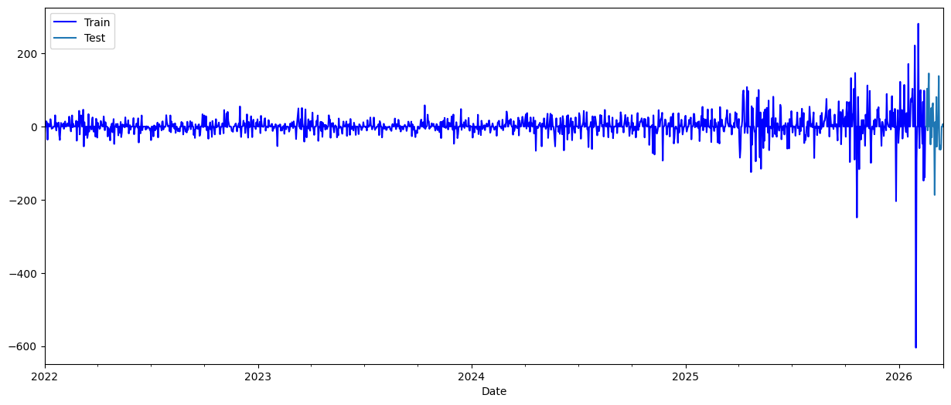
DATA SPLITTING & VISUALISATION
Gold price variation over time: training period (blue) and test period (cyan). Noticeable volatility increase in recent years.

Slide 7
FEATURE ENGINEERING & PRE-PROCESSING
Pre-processing Steps
Daily frequency resampling (asfreq('D'))
Forward-fill missing values (ffill)
Min-Max scaling for LSTM Close price series
60-day lookback window for LSTM sequences
Time-based train/test split (no random shuffle)
Target Variable
Daily variation in Close price (var_Close = Closet − Closet−1) Predicting change rather than absolute price reduces non-stationarity.
Why Variation Features?
Differencing removes trend non-stationarity. The final predicted Close price is recovered as:
Closet = Closet−1 + predicted var_Close

Slide 8
SYSTEM PIPELINE
Data Collection
(yFinance)
Pre-processing
& Feature Eng.
Model Training
& Optimisation
Backtesting
(31-day test)
Next-Day
Prediction
Hyperparameter Optimisation
Grid Search + Time-Series Cross-Validation
Preserves chronological order — no leakage
Optimises on MSE → reports RMSE
.
Evaluation Protocol
Backtesting on 31-day out-of-sample test period
All models evaluated on identical test set
Metrics: MAE and RMSE (USD per troy oz.)
.

Slide 9
MODELS
Decision Tree (skforecast)
MLP Neural Network (scikit-learn)
LSTM (TensorFlow/Keras)
Random Forest (skforecast)
Keras Dense Network (TensorFlow)

Slide 10
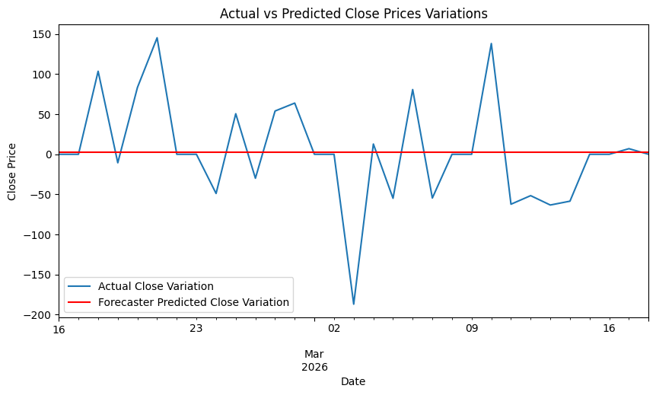
FORECASTER MODEL
Optimal Configuration
max_depth: 1
min_samples_split: 3
ccp_alpha: 0.001
Features: 155 lag-based variation features
Test period: 16 Feb – 18 Mar 2026
Actual range: $4,882.90 – $5,294.40
Predicted range: $4,885.59 – $5,297.09
.
66.03
103.01
actual vs Predicted daily gold price variation
MAE
RMSE

Slide 11
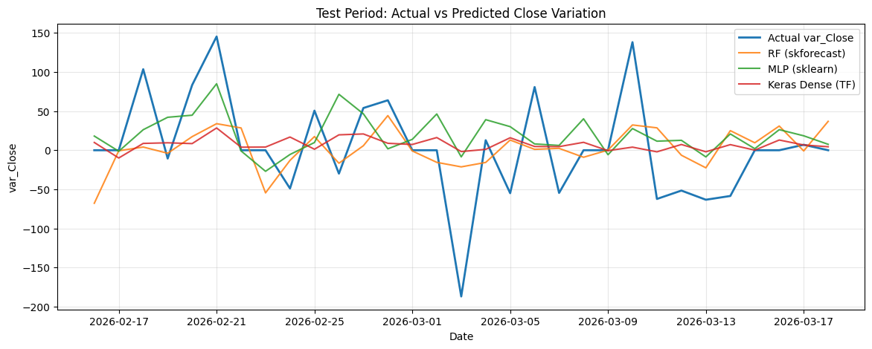
RANDOM FOREST MODEL RESULTS
Optimal Configuration
Framework : ForecasterRecursive
Regressor : RandomForestRegressor
lags : 30
n_estimators : 500
random_state : 123
n_jobs : -1 (all cores)
Features : 155 var_Prev lags
Scaler : None (tree-based)
47.14
61.13
actual vs Predicted daily gold price variation
MAE
RMSE

Slide 12
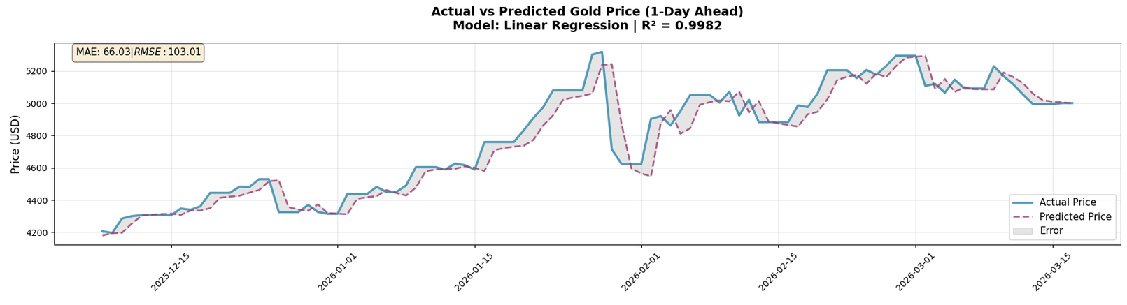
LINEAR REGRESSION MODEL
Optimal Configuration
Class : MLPRegressor
hidden_layer_sizes : (256, 128, 64)
activation : relu
max_iter : 1000
early_stopping : True
validation_fraction : 0.1
n_iter_no_change : 20
Scaler : StandardScaler
actual vs Predicted daily gold price variation
48.10
61.55
MAE
RMSE

Slide 13
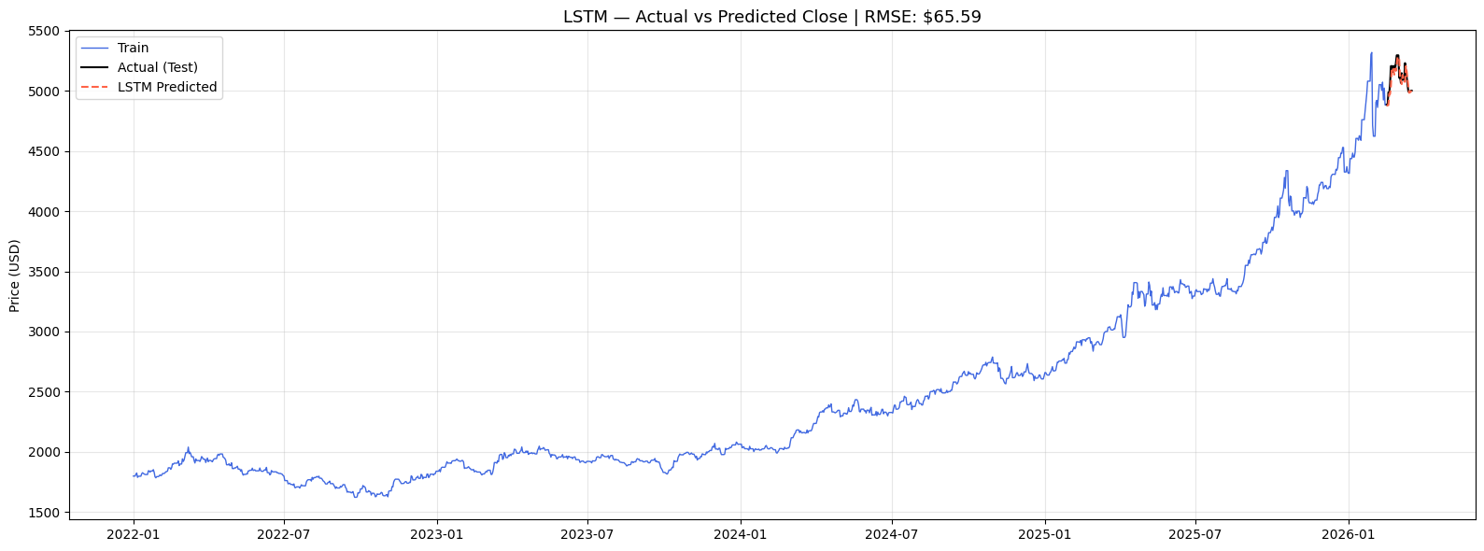
FORECASTER PERFORMANCE
Optimal Configuration
Architecture : LSTM(128)→LSTM(64)
Output layers : Dense(25)→Dense(1)
return_sequences : True (1st), False (2nd)
Optimizer : Adam
Loss : MSE
Lookback window : 60 days
Epochs : 100 (max)
Batch size : 32
EarlyStopping patience : 10
val_split : 0.1
Scaler : MinMaxScaler (0,1)
38.76
52.14
actual vs Predicted daily gold price variation (main forecaster)
MAE
RMSE

Slide 14
COMPARISON TABLE
Model | RMSE | MAE
Random Forest (skforecast) | 61.13 | 47.14
MLP Neural Network (scikit-learn) | 103.01 | 66.03
linear Regression (scikit-learn) | 61.55 | 48.10
LSTM (TensorFlow/Keras) | 52.14 | 38.76

Slide 15
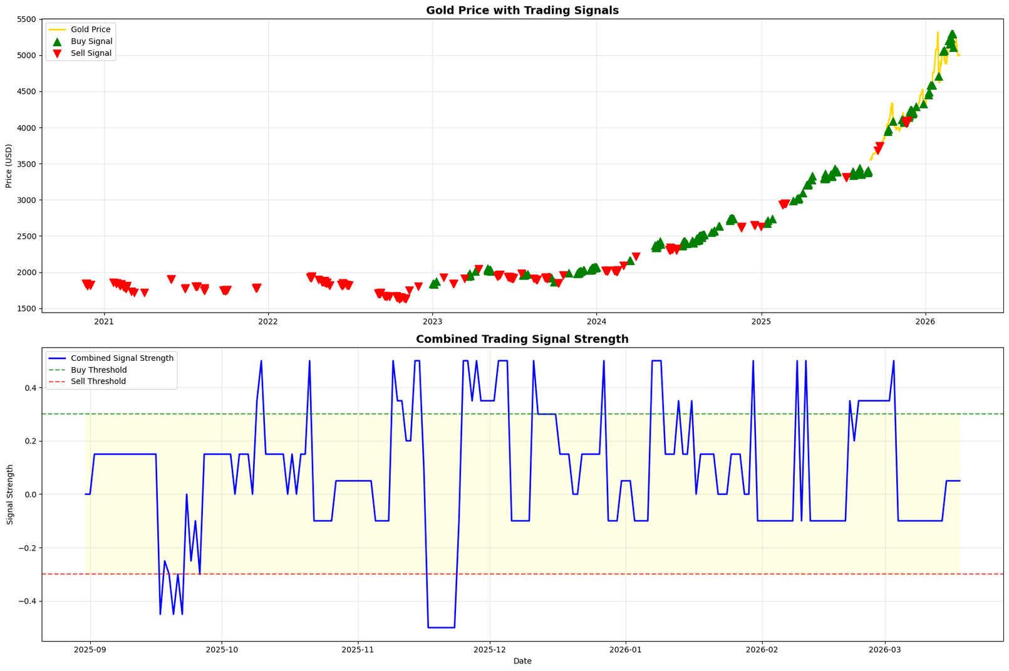
TRADING SIGNALS ANALYSIS

Slide 16
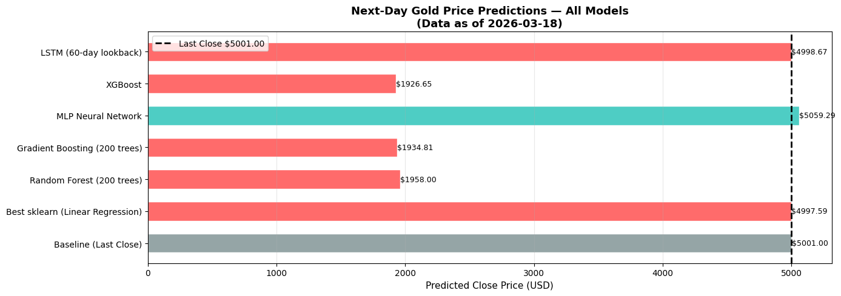
NEXT DAY PREDICTION

Slide 17
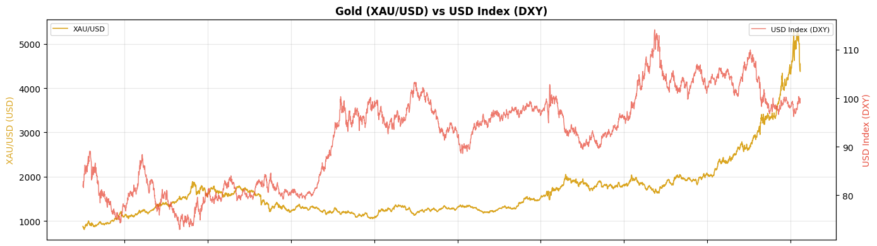
MACRO-ECONOMIC INDICATORS
DXY
USD Index

Slide 18
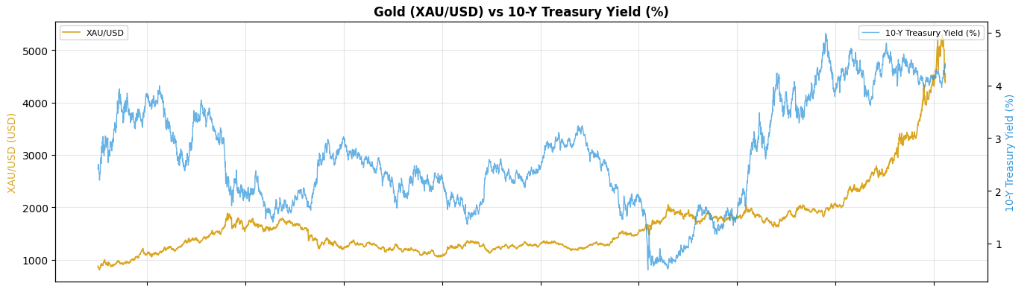
MACRO-ECONOMIC INDICATORS
US10Y
Treasury Yield

Slide 19
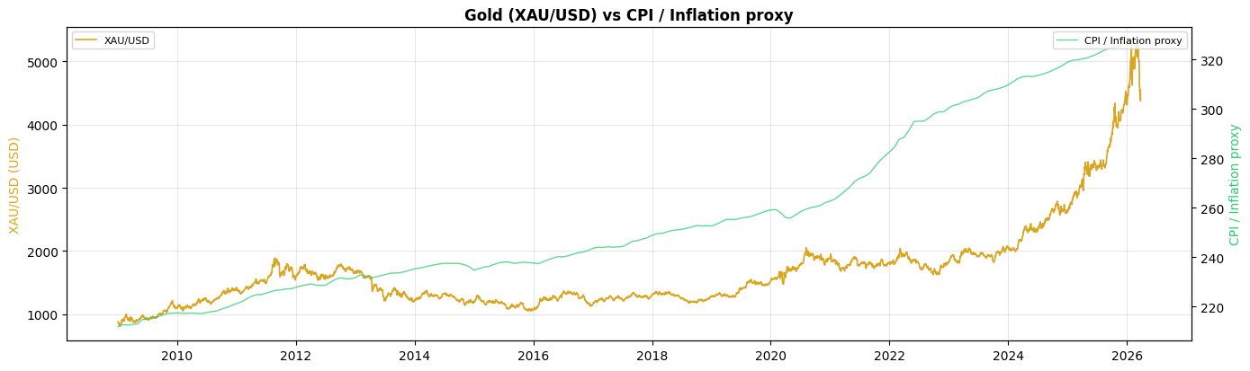
MACRO-ECONOMIC INDICATORS
CPI
Inflation

Slide 20
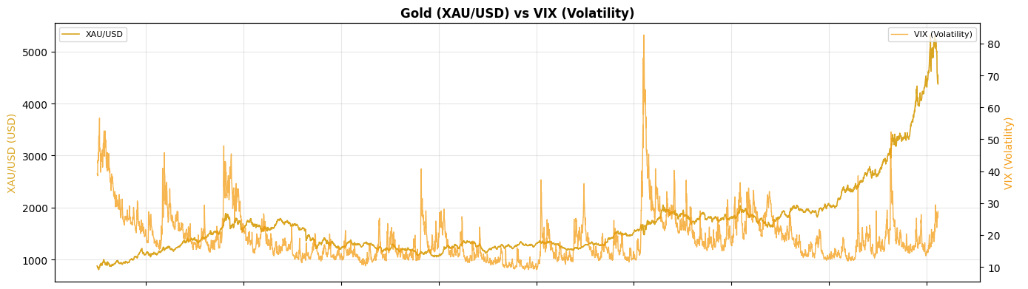
MACRO-ECONOMIC INDICATORS
VIX
Volatility

Slide 21
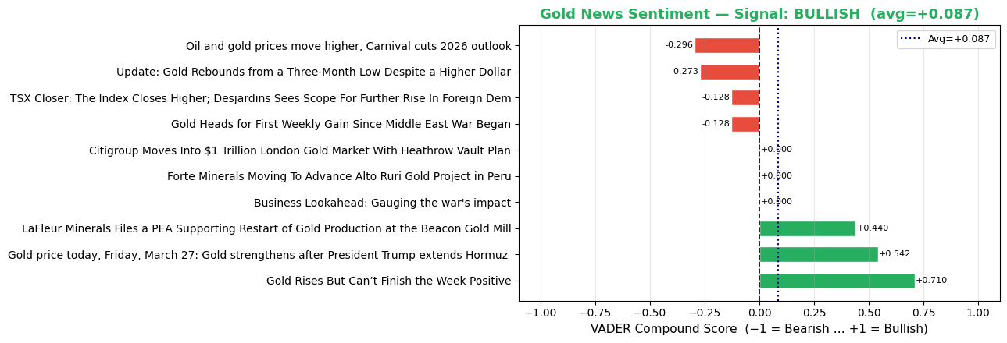
SENTIMENT ANALYSIS — VADER NLP ON GOLD NEWS
VADER NLP — How It Works
Rule-based NLP — no API key, no training needed
Score range: −1.0 (Bearish) to +1.0 (Bullish)
Threshold: > +0.05 = BULLISH; < −0.05 = BEARISH
Headlines from GC=F Yahoo Finance news feed
+0.087
BULLISH
10
Avg Compound
Signal
Headlines

Slide 22
CONCLUSION & FUTURE WORK
CONCLUSION
FUTURE WORK
OBJECTIVES ACHIEVED
A complete daily gold price forecasting system was built and evaluated
Multivariate LSTM achieved the best RMSE of $52.14
Random Forest (61.13) and MLP (61.56) are close 2nd and 3rd
LSTM excels when given sufficient data + multivariate features
Daily rolling strategy makes the system practically deployable
All project objectives were successfully achieved
Incorporate macro indicators (interest rates, CPI, USD index)
Add news sentiment analysis
Extend forecasting horizon (3-day, 7-day)
Explore Transformer-based architectures
Build an interactive dashboard for real-time prediction visualisation
Hybrid model: ARIMA + ML residual correction
Next-day forecasting system built
skforecast implemented
RF, MLP, Keras, LSTM compared
MAE & RMSE evaluation completed
Daily rolling prediction implemented

Slide 23
REFERENCES
Atsalakis, G.S. & Valavanis, K.P. (2009). Forecasting stock market short-term trends using a neuro-fuzzy methodology. Expert Systems with Applications, 36(7), 10696–10707.
Box, G.E.P. et al. (2015). Time Series Analysis: Forecasting and Control. 5th edn. Wiley.
Breiman, L. (2001). Random forests. Machine Learning, 45(1), 5–32.
Hochreiter, S. & Schmidhuber, J. (1997). Long short-term memory. Neural Computation, 9(8), 1735–1780.
Khashei, M. & Bijari, M. (2011). A novel hybridization of ANNs and ARIMA. Applied Soft Computing, 11(2), 2664–2675.
Kumar, D. & Thenmozhi, M. (2014). Forecasting stock index movement. Journal of Forecasting, 33(6), 466–480.
Nelson, D.M.Q. et al. (2017). Stock market's price movement prediction with LSTM. IJCNN, 1419–1426.
Patel, J. et al. (2015). Predicting stock price index movement. Expert Systems with Applications, 42(1), 259–268.
Tsai, C.-F. & Wang, S.-P. (2009). Stock price forecasting by hybrid ML. IMECS Proceedings, 755–760.
Yahoo Finance (2026). Gold Futures GC=F. Available at: https://finance.yahoo.com/

